Slide 1
3Q Scheduler
By: Maksym, Aidan, and Josh

Slide 2
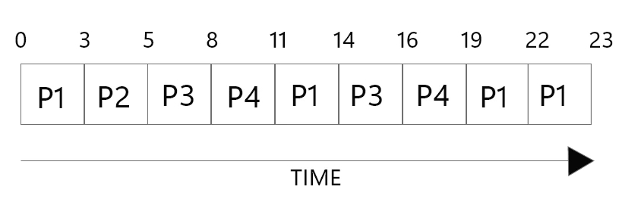
Original OS161 Scheduler
Basic Round Robin scheduler
Uses the OS161 implementation of a queue
The built-in queue allows us to access the head and the tail
Very basic error handling, kernel panics whenever something goes wrong
On an error, all of the threads in the queue are freed and the queue is then destroyed
A thread is made runnable by being added to the end of the queue
The next thread that runs is chosen by removing the head of the queue

Slide 3
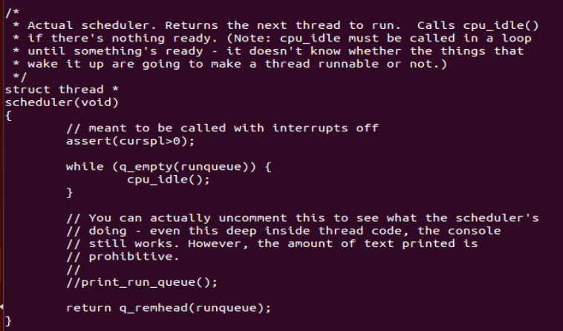
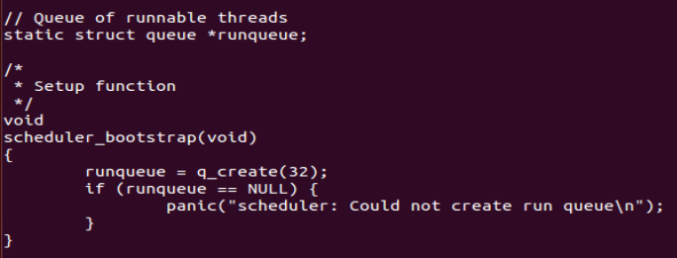
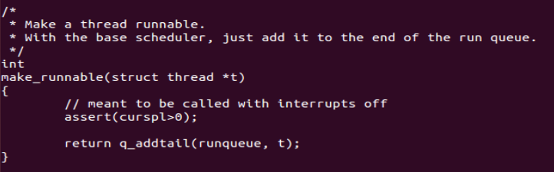
The Implementation of the Default Scheduler

Slide 4
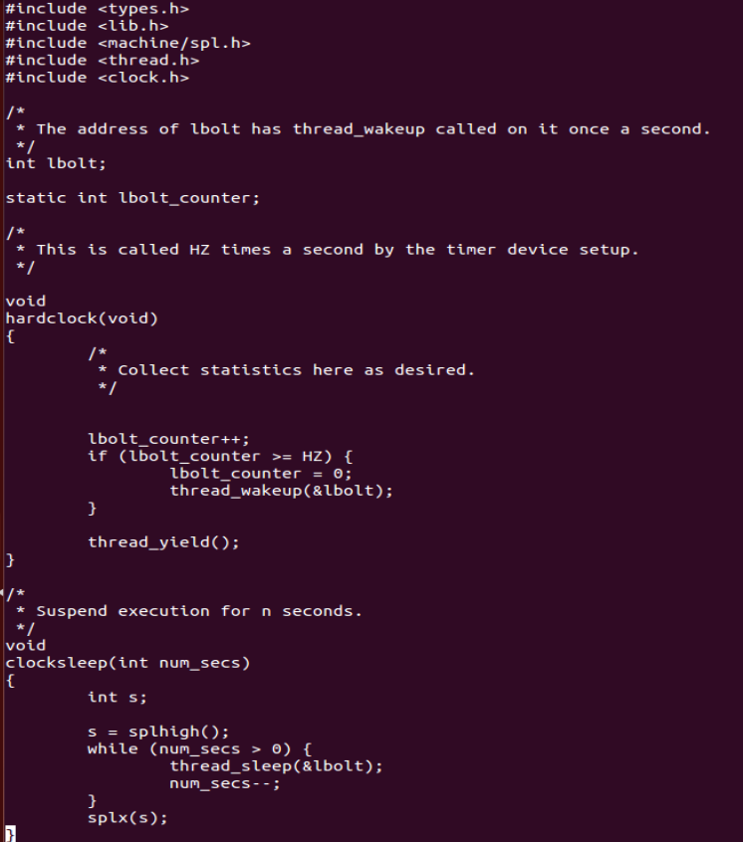
The Clock Associated with The Default Scheduler

Slide 5
Original hardclock.c
The hardclock function is called HZ (originally 100) times per second
Each function call ends with thread_yield(), essentially giving up the CPU
lbolt_counter is incremented each call, if it is greater than or equal to HZ, we set it to 0 and wake up a thread on &lbolt
Allows a thread to sleep for a certain number of seconds, each time a second passes we call wake up on lbolt

Slide 6

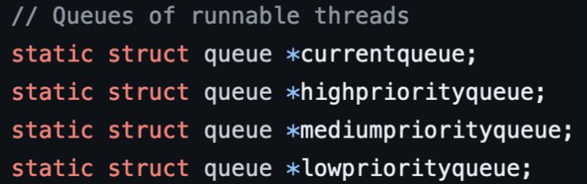
MLFQ with 3 Separate Queues
Problems with default scheduler:
The lack of flexibility
No prioritization
Scheduling Solution:
Give higher priority to processes that do not take up their whole time quantum
This allows for processes that are I/O bound or user-interactive to have a fast response time.
Give a lower priority to processes that use their whole time quantum

Slide 7
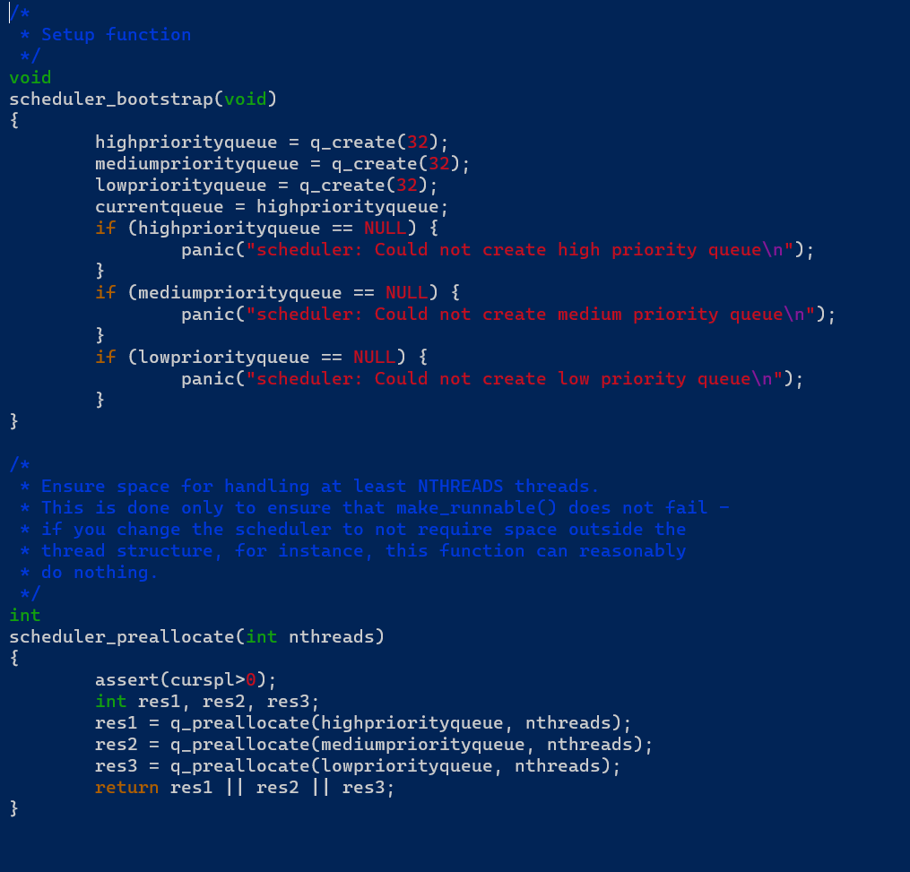
Bootstrap/Scheduler Setup
The built-in queue implementation is utilized to create the MLFQ which consists of three queues.
Memory is allocated for the given number of threads in each queue.

Slide 8
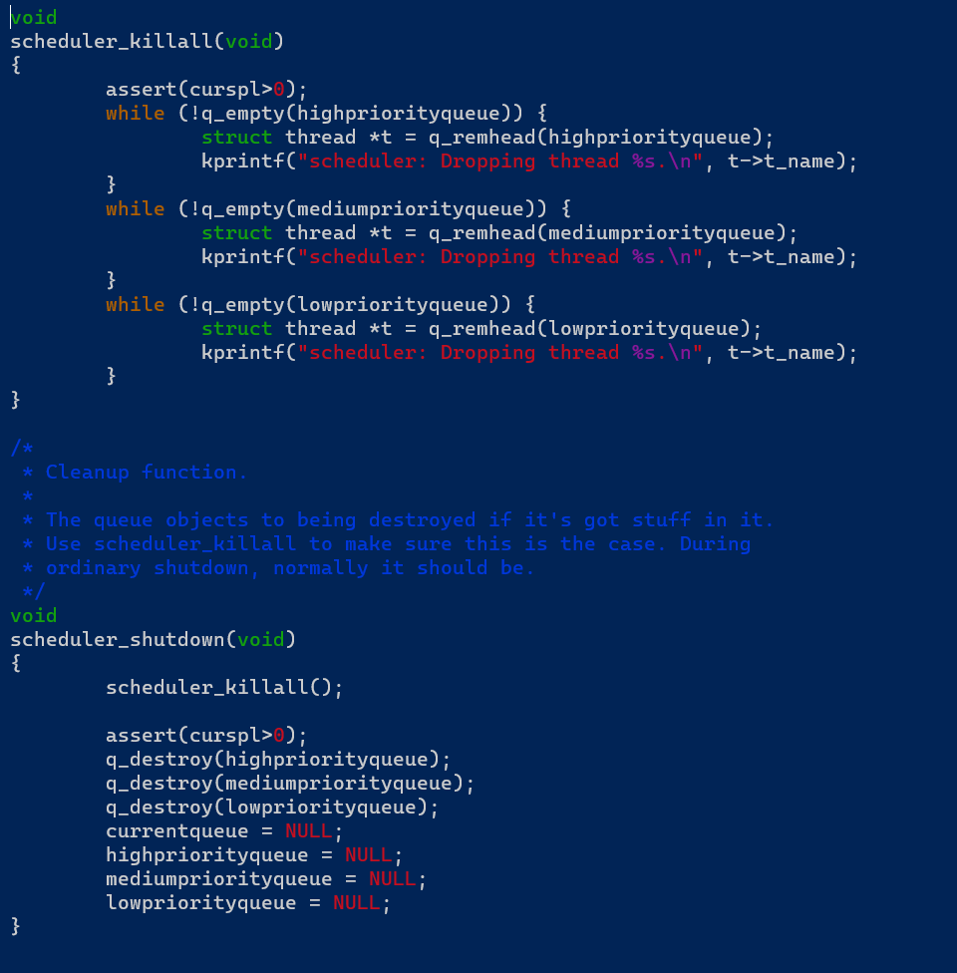
Scheduler Cleanup

Slide 9
Priority on Context Switch
We want to be able to determine if a thread has used up its entire time slice, or whether it has given execution back to the operating system before its time slice is up.
If a context switch happens and the thread is in the ready queue, it has used up its whole time slice
If a context switch happens and a thread is in the sleeping queue, it must have yielded execution.
Therefore, priority changing logic is implemented in the context switch code.

Slide 10
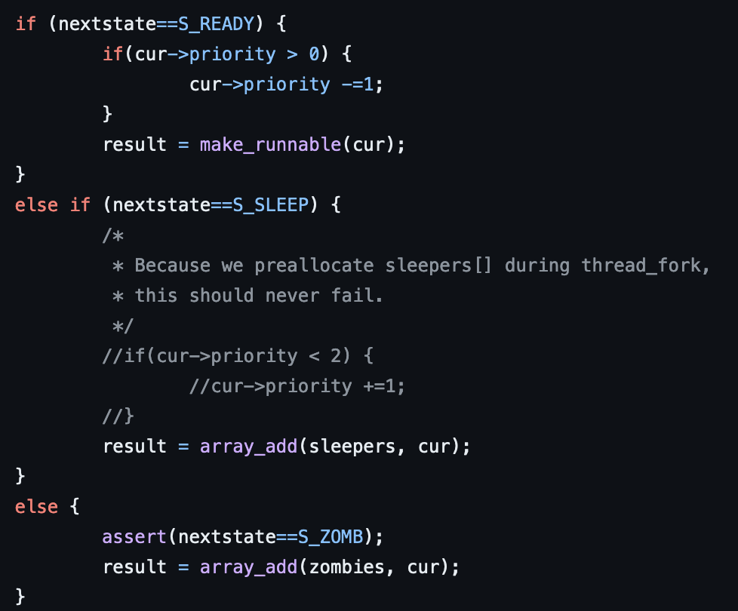
Starvation Policy for Low Priority Processes
Our implementation of MLFQ grants each process a fast response time, since each process is initially assigned to the highest priority, processes that are moved down priority can sometimes be ignored by the scheduler. To assist this, we have implemented an aging policy and a policy for running queue selection.

Slide 11
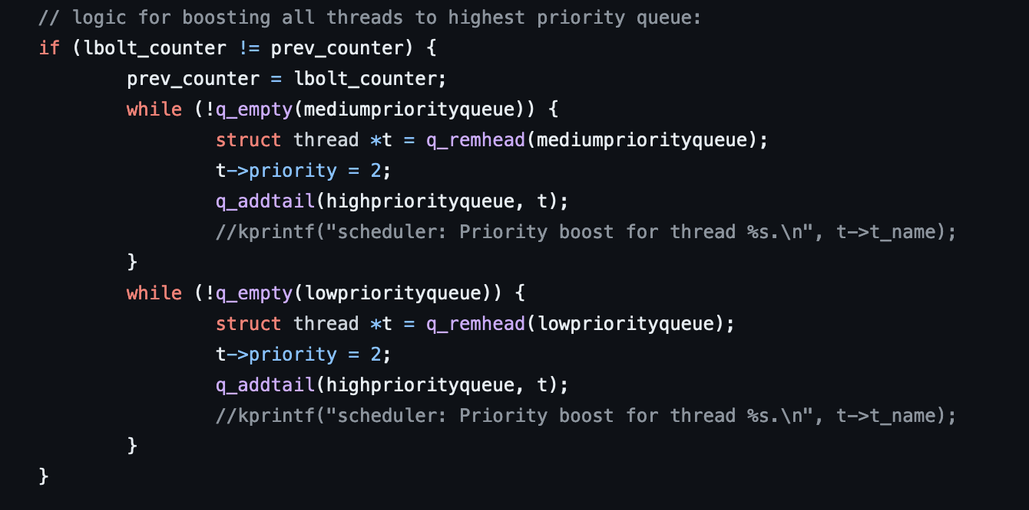
Aging Policy
The implementation of a priority boost will prevent tasks that are placed in the middle or low priority queues from starving. Priority boosts are performed at a rate of 90 boosts per second using the built-in hardclock.

Slide 12
Running Queue
Each queue is given a certain time quantum. Higher priority queues are given shorter time quantums.
Priority is always given to the highest priority queue (with priority 2). For every 10 time quantums run from the queue with priority 2, 1 time quantum is run from the queue with priority 1. For every 50 time quantums run from the queue with priority 2, 1 time quantum is run from the queue with priority 0.
This is to prevent starvation from lower priority queues. If the highest priority queue is always selected, the lower priority queues will have to wait for higher priority queues to be empty before they can run.

Slide 13
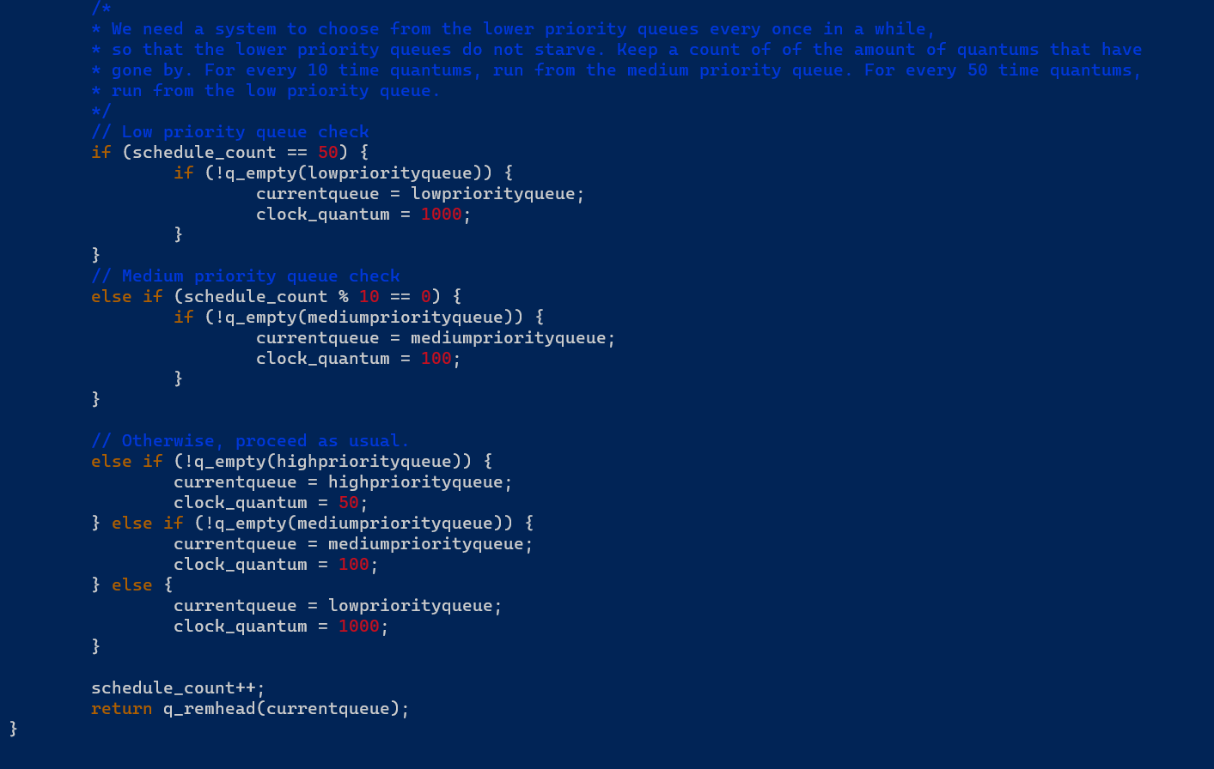
Running Queue Implementation

Slide 14
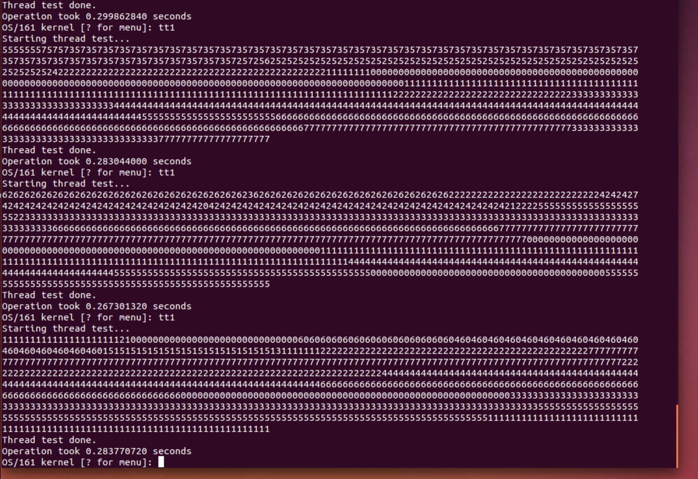
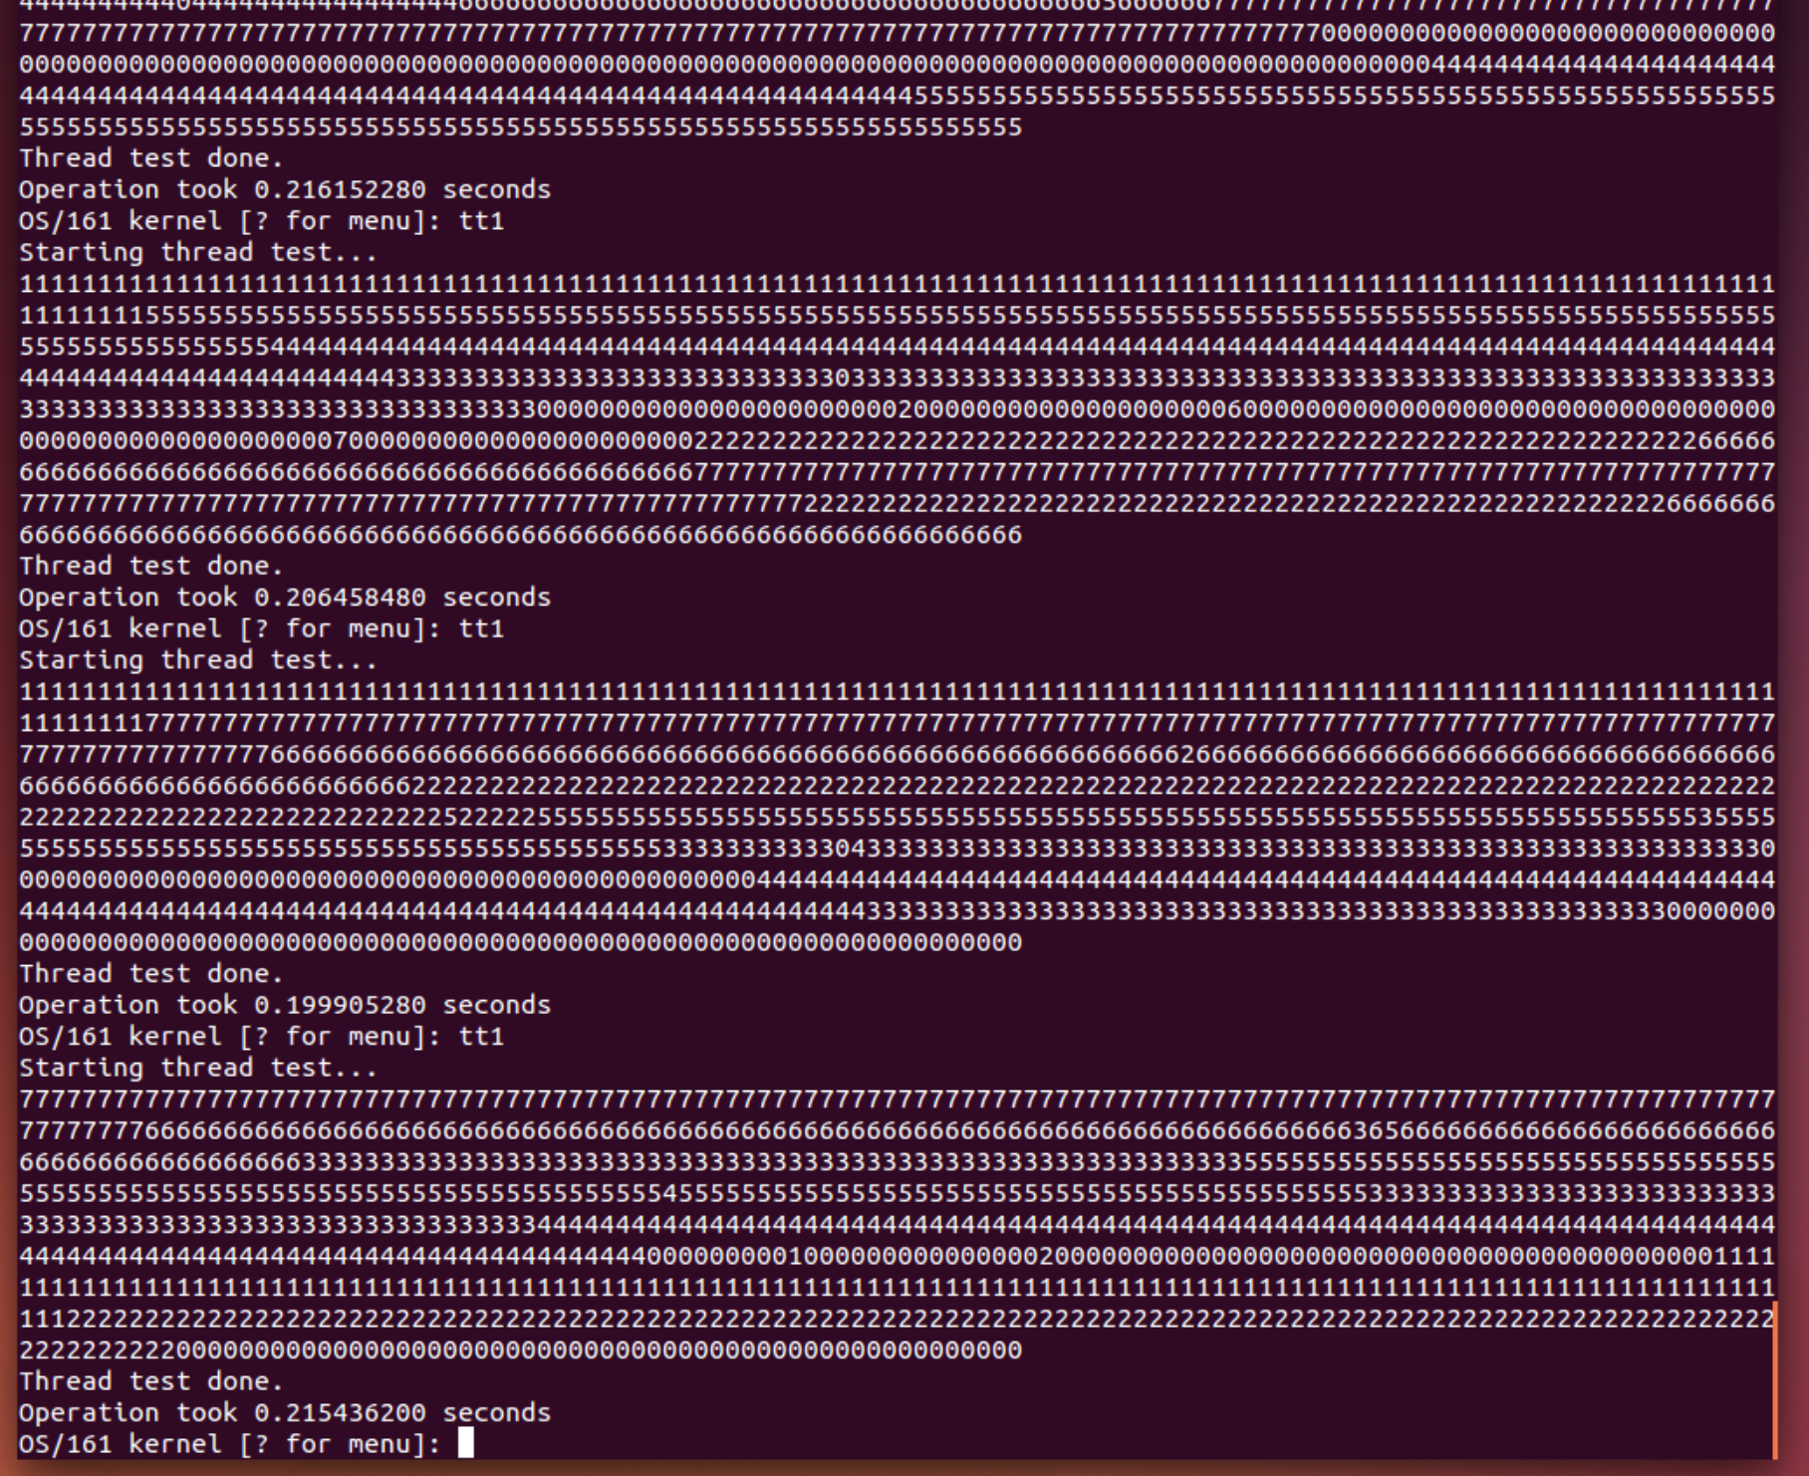
Built In tt1 OS161 Thread Test
MLFQ Scheduler
Original Scheduler

Slide 15
Built in tt3 OS161 Test
The OS161 thread tests are used to gauge the effectiveness of the MLFQ scheduler. The tt3 program simulates I/O bound processes competing with process that use the CPU heavily.
Because MLFQ prioritizes short-burst processes and assigns each thread with the same priority at the beginning, the overall time performance of tt3 is almost identical or slightly worse compared to the OS161 basic round-robin scheduler.
The overhead of having multiple queues and using aging contribute to this slightly worse performance.

Slide 16
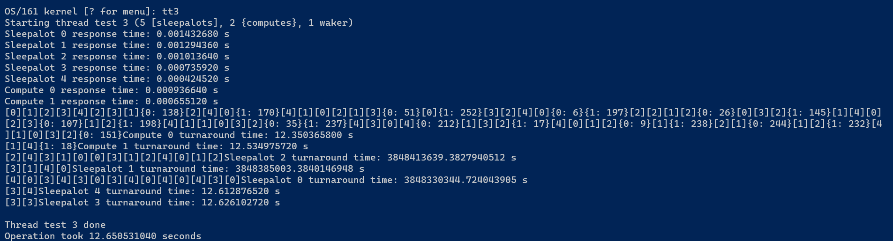
Each process is placed in the highest priority queue first, giving each process a fast response time.

Slide 17
Scheduling for Each Queue
Different implementations of MLFQ can use different schedulers for various workloads. In our case, we implemented round-robin scheduling for the high, medium, and low priority queues. We gave the high priority queue the shortest time quantum, and we gave the low priority queue the longest time quantum. Our reasoning behind this was to give multiple short-burst processes high interactivity, while giving longer-running processes more sporadic but longer periods to run which would reduce the overhead from context switching.

Slide 18
Questions?

